Slide 1

CONTENT-BASED
MOVIE RECOMMENDATION
Front page
USING AN INTERACTIVE CONVERSATIONAL AGENT (CHATBOT)
BARATSAS
SOTIRIS
f2821803
SPANOS
NIKOS
f2821826

Slide 2


Who we are
Sotiris Baratsas
Nikos Spanos

Slide 3
Presentation Outline
1
2
3
4
The Challenge
Trends & Existing Solutions
Our Solution
Potential Applications

Slide 4
The Challenge
Build an effective movie recommendation system
It might be difficult for a person to find a new movie to watch, however they usually know what they are in the mood for (a specific genre usually) and they also know a few other movies they already like.

Slide 5



Movie Recommendation Approaches
Popularity-based
recommenders
Content-based
recommenders
Collaborative
Filtering

Slide 6

Chatbots trend
“Chatbots” is one of the fastest growing digital trends.
In certain countries, consumers declared they actually prefer
interacting with text & voice assistants instead of humans.

Slide 7

Understanding our user
GAINS
Get insightful movie recommendations
Save time browsing movie lists
GAIN CREATORS
Smart movie recommendations based on insights about the user
Works with popular applications (e.g. Messenger, Viber, Amazon Echo)
Intuitive user experience
JOB-TO-
BE-DONE
Find a movie to watch that she is likely to enjoy
PRODUCT
A smart movie recommendation chatbot
PAINS
Need to browse many websites, read plots and watch trailers
Need to download new applications to find recommendations
PAIN RELIEVERS
No need to download a dedicated application. Works within popular (already installed) apps.
Saves time from browsing recommendation lists
USER PROFILE
VALUE PROPOSITION

Slide 8
“
As a user, I want to get recommendations based on a movie I already like,
so that I can find a new movie to watch.

Slide 9
Optimal user journey
User wants to watch a movie, but doesn't know which one.
User opens messenger and sends a message to "Kelly MovieBot".
Kelly ask the user to provide a Genre they prefer.
User provides a Genre (e.g. Scifi)
User provides reasons (e.g. name of actor, plot, genre, or other elements)
Kelly ask why the user liked that movie.
User provides a movie they have already watched and like.
Kelly asks the user to mention a movie they like.
Kelly recommends 2 movies and send their imdb links to the user.

Slide 10
OUR SOLUTION

Slide 11

Initial Approaches
Train embeddings using Wikipedia links
Train FastText embeddings using movie characteristics
(e.g. actors, plot, genre, director, etc)

Slide 12
Using Wikipedia Links
MAIN IDEA
Parse Wikipedia, create a dataset of articles about movies and their links to internal or external URLs. Train embeddings using pairs of {movies, links}. Based on a user input (=a movie they already like), recommend the movies mapped closer to that one.

Slide 13
Using Wikipedia Links
MAIN IDEA
Parse Wikipedia, create a dataset of articles about movies and their links to internal or external URLs. Train embeddings using pairs of {movies, links}. Based on a user input (=a movie they already like), recommend the movies mapped closer to that one.
WHY IT WORKS
Nature and structure of the links

Slide 14
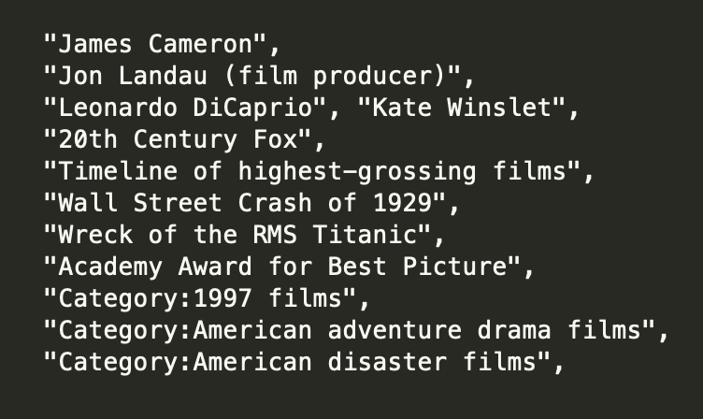
Using Wikipedia Links
Example Links for
Titanic (1997 film)

Slide 15
Using Wikipedia Links
MAIN IDEA
Parse Wikipedia, create a dataset of articles about movies and their links to internal or external URLs. Train embeddings using pairs of {movies, links}. Based on a user input (=a movie they already like), recommend the movies mapped closer to that one.
WHY IT WORKS
Nature and structure of the links
Mapping of movies, as well as links

Slide 16
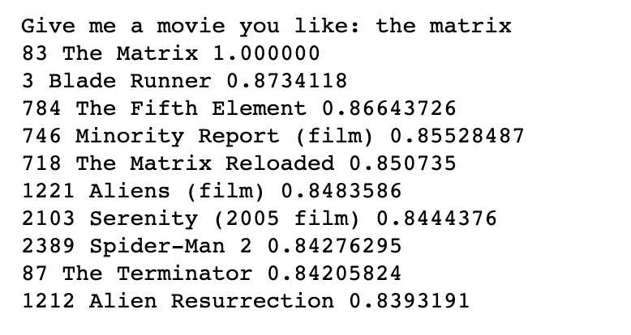
Using Wikipedia Links

Slide 17
Using Movie Characteristics & FastText
MAIN IDEA
Start with an iMDb dataset with 5000 movies.
Parse using BeautifulSoup to extract information (i.e. plot summary & imdb rating) + Data Cleaning
Create word embeddings based on cast, plot, genre, director
Create a scoring and matching algorithm based on cosine distance (1-cosine similarity)
WHY IT WORKS
Takes into account a combination of different movie features
Maps words using the FastText algorithm
Takes into account user inputs to penalize or reward

Slide 18



Components
WEBHOOK
MESSENGER API
Python Script
Dialogflow
Messenger
Access to dataset
Embeddings
Scoring algorithm
Matching algorithm
Manages conversation
Records user inputs and passes them to Python
Mediator between UI and back-end
User interaction
Matching output

Slide 19


Cleaning & Transformations
Duplicate links on the dataset.
Separated in different column each of the 7 genres a movie may had.
Clean every string (object variable) from extra spaces and special characters.
We built two functions to correct the genre and the movie title given as input by the user.
Clean every string (object variable) from extra spaces and special characters.
We combined the value from each column to a unified text per movie.
Update the column IMDB Rating and scrapping the summary plot of each movie
Drop columns that we didn’t want.
Drop the rows were the duration was less than 70 minutes. Since we observed that in the dataset we had also Series episodes.
Create a naive approach of comparing the movies to each other.

Slide 20



Embeddings
Cast Embeddings
Plot Embeddings
Features Embeddings
Skipgram vs CBOW
Controls the size of the vectors
Learning Rate
(Too high can cause
the model to overfit)
Window Size
(stochastic)

Slide 21
Recommendation algorithm
Phase 1
Phase 2
Phase 3
Input Genre
Input Movie Title
Input reasons you like the above movie
Clean the above inputs if appropriate
Slice the dataset based on the genre given as input.
Check with an If/Else statement whether the movie is in the movies_list.
If TRUE then we follow the approach of cosine distance and word embeddings.
After this step we filter the 5 most similar movies to the one chosen from the user.
If FALSE we skip the cosine distance approach since we miss the important columns.
Calculate the movie scoring based on three scoring parameters:
Primary Genre (x0.2)
IMDB Rating (x0.3)
Number of Words (x0.5)
Out of the 5 movies selected from cosine distance in Phase 2 we recommend the 3 movies with the highest scoring.

Slide 22
LET’S SEE A DEMO

Slide 23

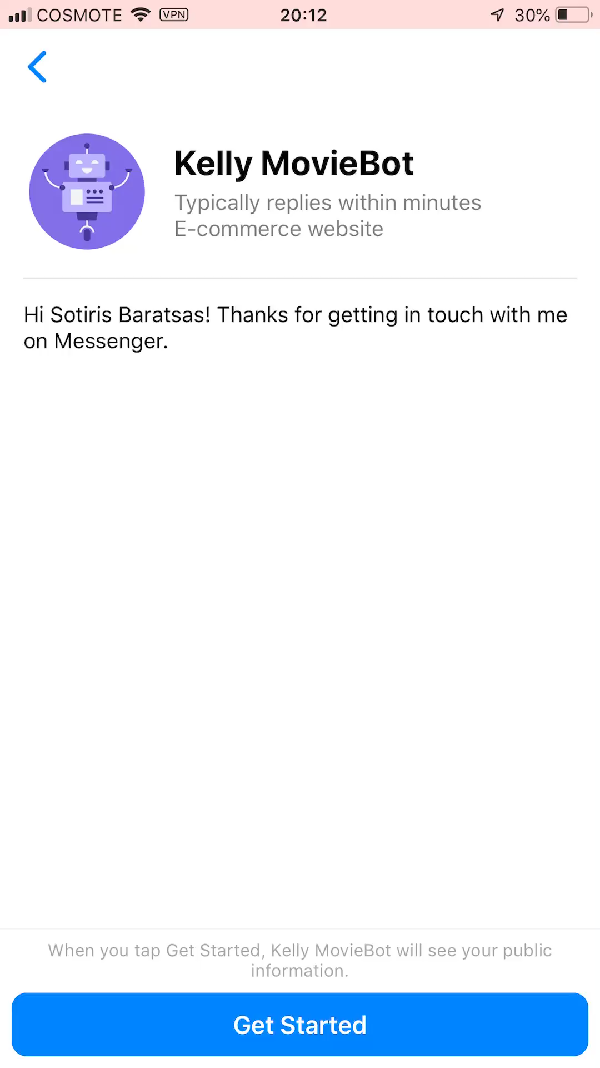

Slide 24
NEXT STEPS

Slide 25



Improvements
Better configuration of dialogue engine
Larger
dataset
Optimize scoring & matching algorithms

Slide 26


Potential Business Applications
Deploy this to a cinema to boost sales
Create an audience-facing entertainment app, sponsored by streaming companies

Slide 27
THANK YOU
Front page
for your attention
BARATSAS
SOTIRIS
f2821803
SPANOS
NIKOS
f2821826

Slide 28
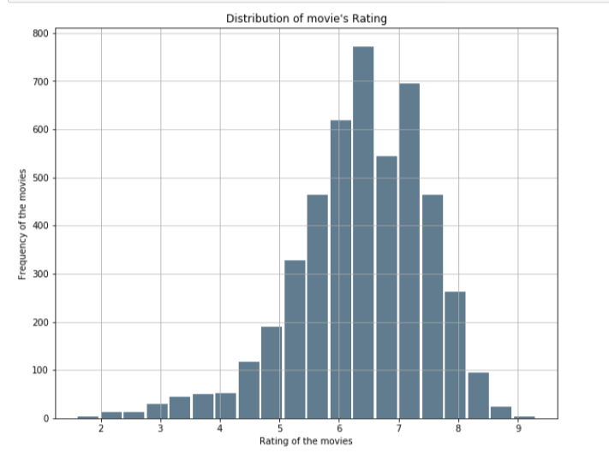
Frequency of movie rating

Slide 29
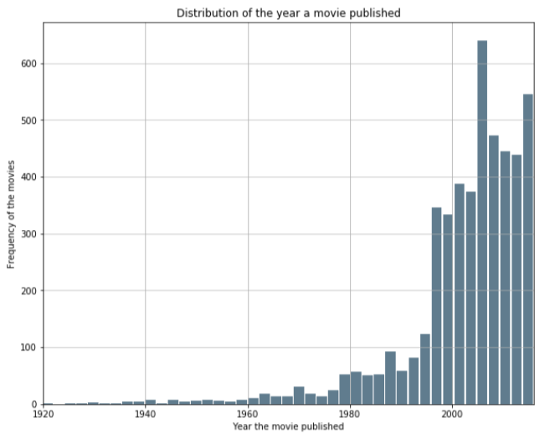
Year of publish

Slide 30
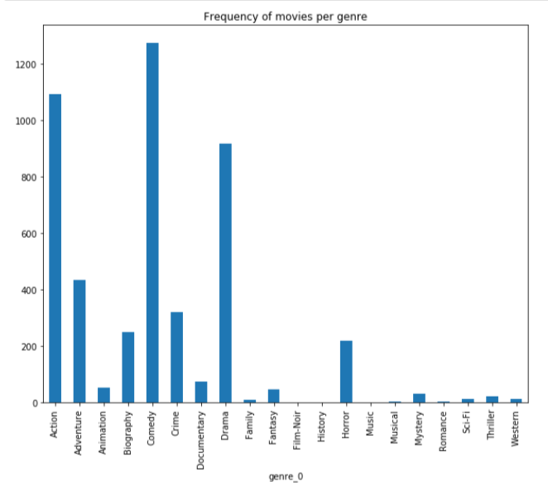
Primary genre

